Slide 1
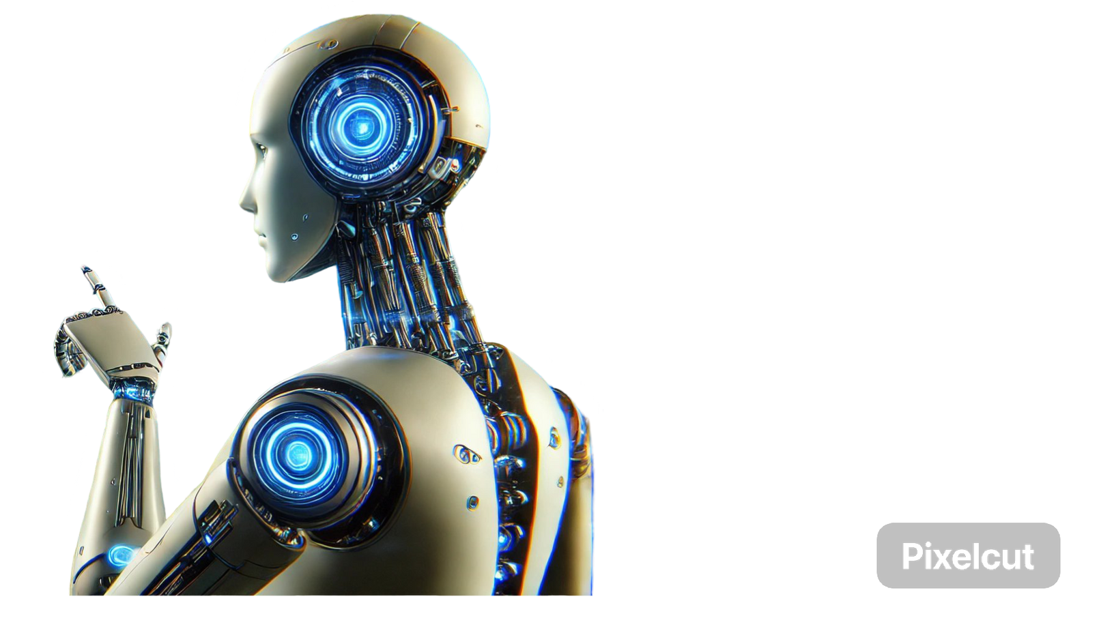
MCP TEAM 2 BOYS BATCH 61 MORNING
Model Context Protocol
Building AI Agents with CrewAI & LiteLLM
MADE BY
WAJAHAT HUSSAIN

Slide 2


Understanding Model Context Protocol (MCP)
Definition
Primary Goal
Key Features
MCP is an open standard created by Anthropic that provides a secure, standardized way for AI assistants (e.g., Claude) to interact with external data sources such as GitHub, Google Drive, Slack, and more.
Enhance AI capabilities by allowing access to real-time, relevant data and context, thereby generating more accurate responses.
Universal Connectivity: One standardized method to interface with multiple data sources.
Client-Server Architecture: Differentiates between MCP Hosts (client applications) and MCP Servers (data/function providers).
Secure Data Access: Controlled sharing of information with robust security.

Slide 3
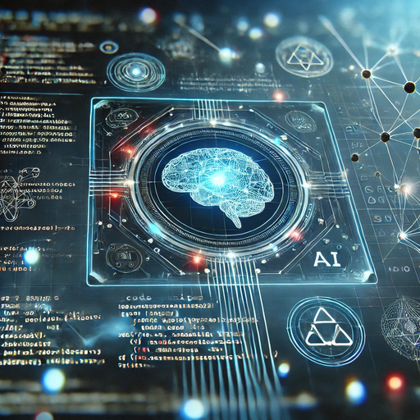


Key Features of
Model Context Protocol
Universal Connectivity:
Client-Server Model:
Secure Data Access:
Streamlines integration by eliminating the need for custom connectors for every data type.
Clearly defined roles with MCP Hosts initiating connections and MCP Servers providing data/services.
Ensures that data is only shared in a controlled and secure manner.

Slide 4




Integrating Model Context Protocol in CrewAI
Benefits of MCP Integration:
Standardized Data Access: Uniform interface for AI agents to securely access multiple external data sources.
Enhanced Agent Capabilities: Ability to leverage tools (e.g., IBM’s watsonx.ai) through a single protocol.
Simplified Integration: Reduces the need for building custom connectors.

Slide 5
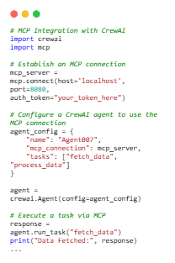

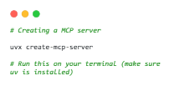
CrewAI Integration with MCP (Code Example)
Use a descriptive line that hypes your event, product, or service. A short and relevant quote works, too!

Slide 6
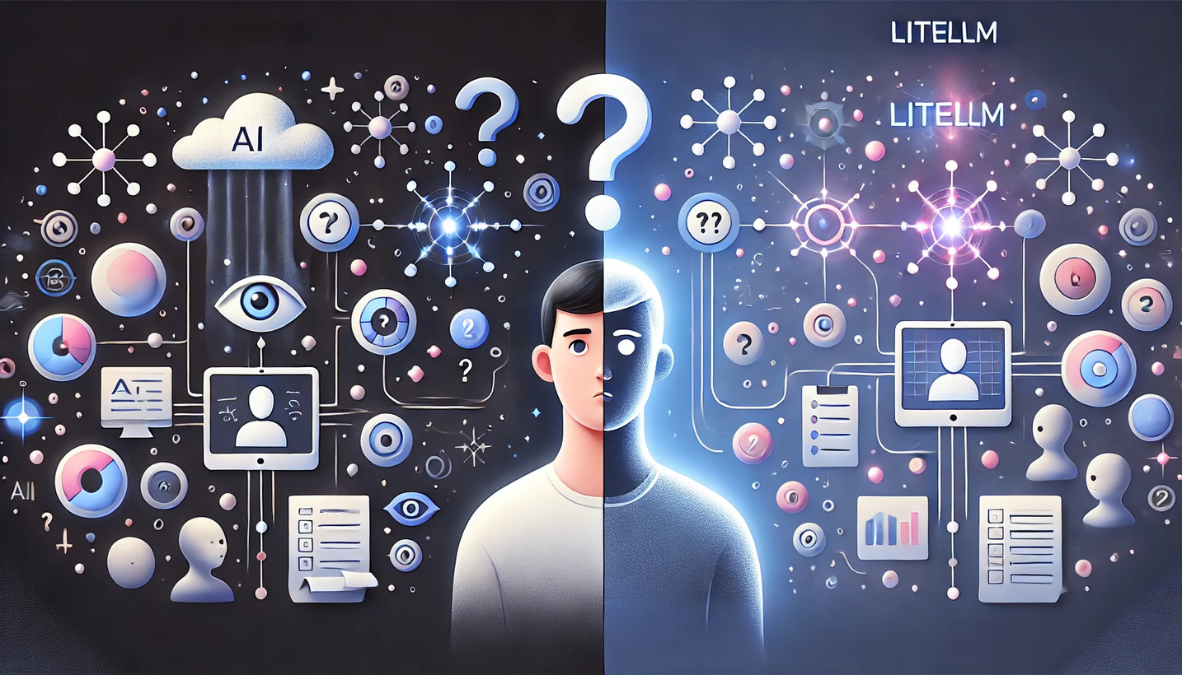
Integrating MCP with LiteLLM
Benefits of MCP Integration:
Enhanced Context: Provides dynamic, real-time contextual data for more accurate model responses.
Streamlined Workflow: Reduces complexity by using a standardized protocol for data access.

Slide 7
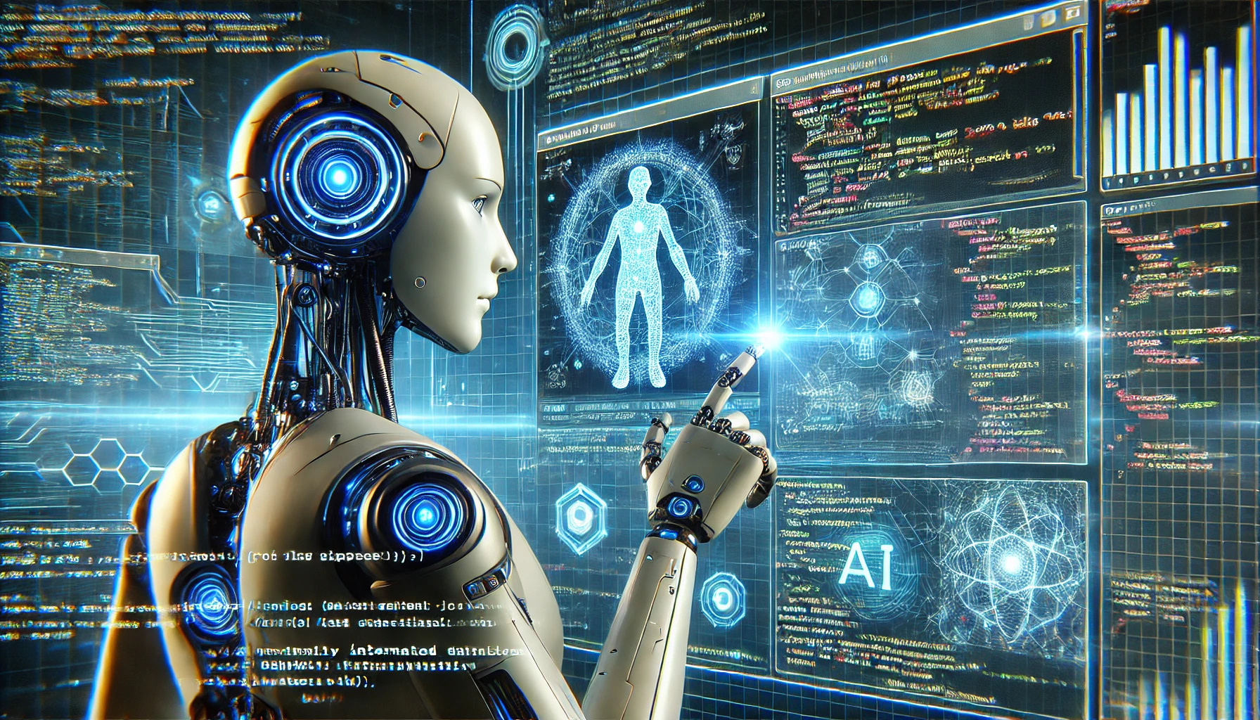
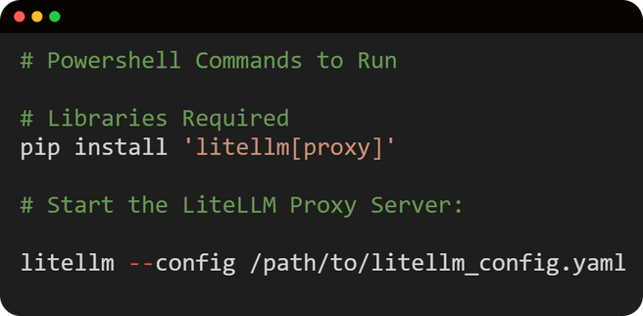
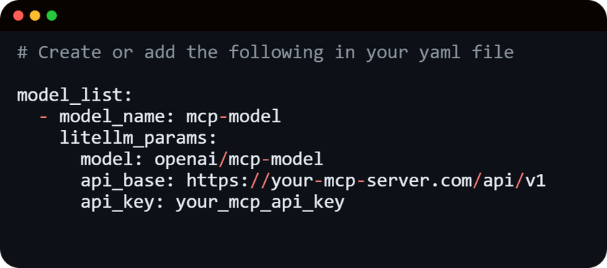
The following code was generated by AI
Integrating Model Context Protocol with LiteLLM
(Code Snippet)

Slide 8

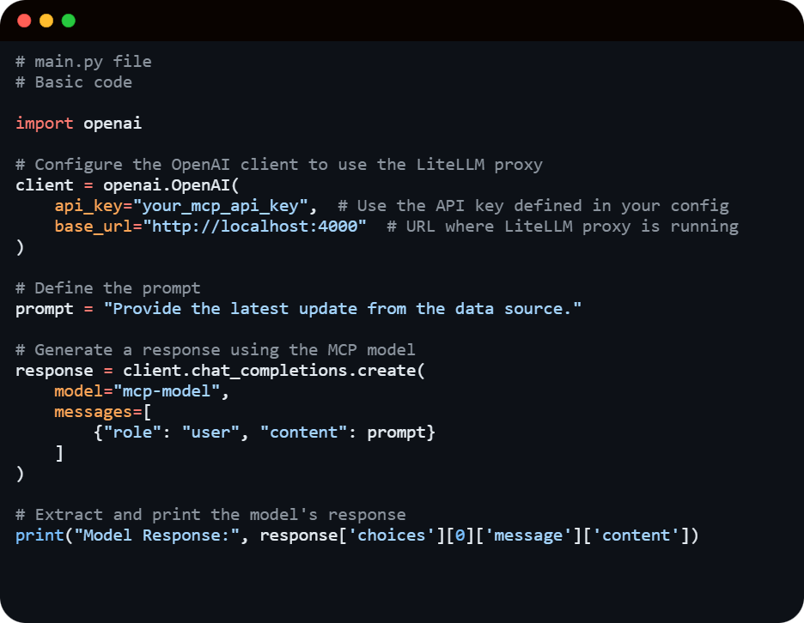
Integrating Model Context Protocol with LiteLLM
(Code Snippet
Basic main.py)
The following code was generated by AI

Slide 9
Summary
Reason for Model Context Protocol (MCP):
Provide real-time, up-to-date information from external sources like databases, cloud storage, or APIs.
Access context-sensitive knowledge that is necessary for specialized tasks.
Integrate securely with different platforms while maintaining data privacy and control.
MCP aims to:
Enhance AI Context Awareness.
Standardize AI Integration.
Improve AI Decision-Making.
Ensure Secure Data Access.
Simplify AI Workflows .
Notes:
Reason and Goal of Model Context Protocol

Slide 10
Thanks for watching
This presentation regarding the topic Model Context Protocol was made by
Wajahat Hussain
CONTACT US
LINKEDIN
Wajahat Hussain Sangi
EMAIL
wajahattt.hussain@gmail.com
GITHUB
www.github.com/wajahattt-dot
Notes:
Reference to Wajahats LinkedIn and GitHub

